Slide 1
Title
Project
Problem description and/or motivation
What problem did you try to solve?
Why should your reader be interested?
System
Functional block diagram
For software solutions, also include software design diagram
Methods
How did you solve your problem? There should be enough information here to allow another engineers to understand your process.
If you had a complicated protocol, it may be helpful to include a diagram, table or flowchart to explain the methods you used.
This is a good place to mention relevant ethical considerations.
Conclusion
Highlight the most significant results.
How do these results relate to the original problem? Does the data suggest that your solution worked?
What further research would be necessary to answer the questions raised by your results?
How do your results fit into the big picture?
What did you learn from doing the project?
Where would you like this project to go from here?
Add logo from https://engineering.usu.edu/about/logos-and-wordmarks in one of the corners of the chart.
Team Members and Contact Information
If appropriate, add thanks to faculty mentor or corporate sponsor.

Slide 2

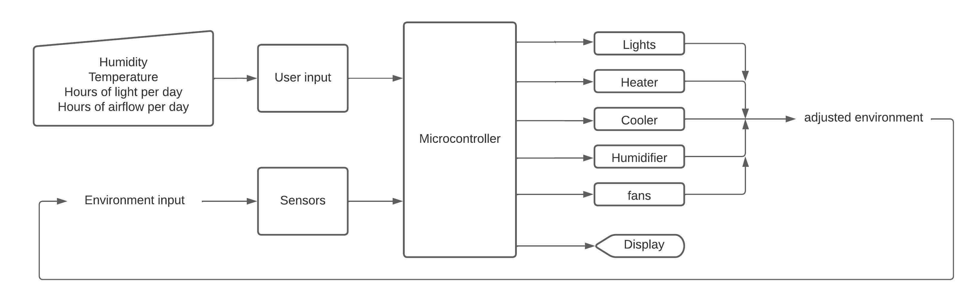
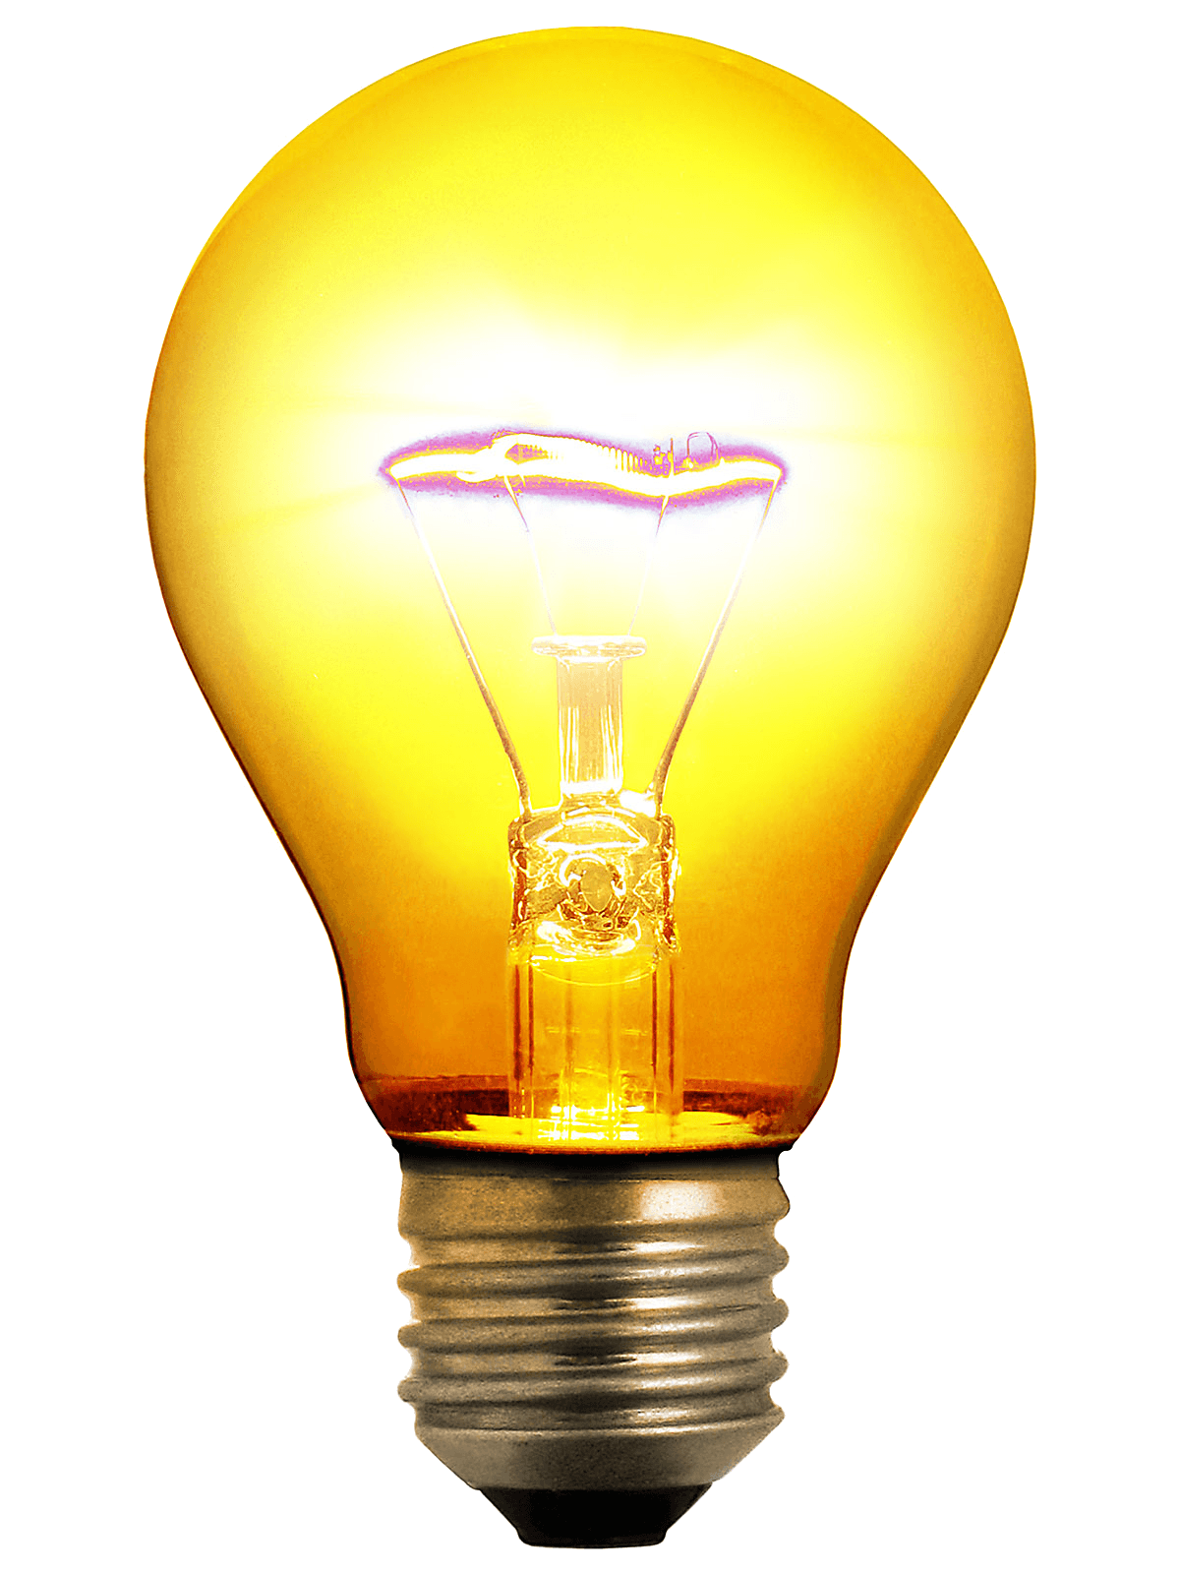
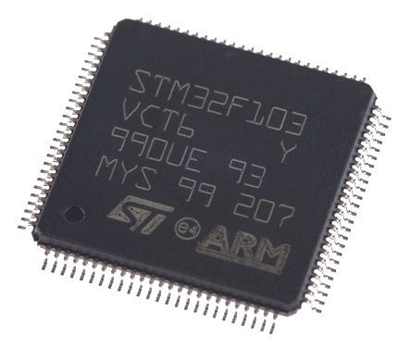

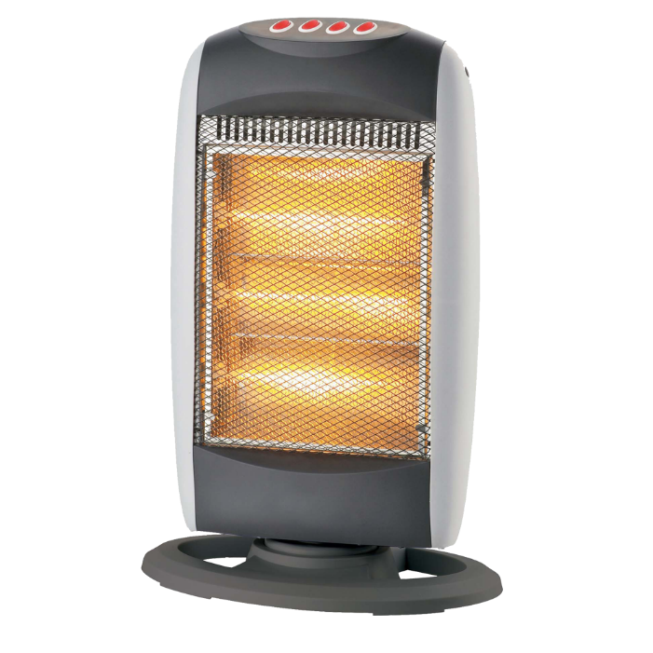
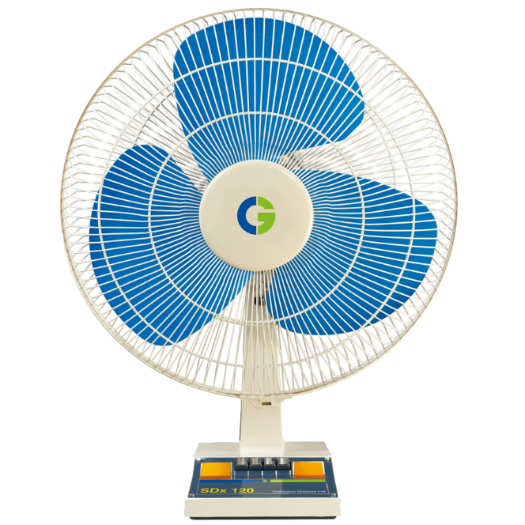

GreenBox
Project
Raising and caring for plant life are some of the most fundamental things we do as a species.
Caring for plants on a small scale can have many benefits.
Large commercial farms are heavily automated to ensure positive results.
GreenBox brings some of this automation into the home, along with its results!
GreenBox combines existing technology with a control system to maintain a desired level of temperature, humidity, light, and air.
System
Methods
Conclusion
The original goal of this project was to monitor and adjust the temperature, humidity, light, and air-flow in the main chamber.
These goals were all met to varying degrees.
Many lessons were learned through this project, many about the importance of planning for unexpected setbacks.
In the future, this could become a much more polished product that does an even better job of maintaining conditions, as well as having more features such as wireless connectivity.
No reason to reinvent the wheel over and over.
Utilizes existing environmental control technologies.
Controls these technologies using a microcontroller, sensors, and timers.
Controls each subsystem’s power source to allow scaling and increase repairability.
Zach Wilcox – Zacdwil@hotmail.com

